Slide 1
MIDI
Notes:
c17593531

Slide 2
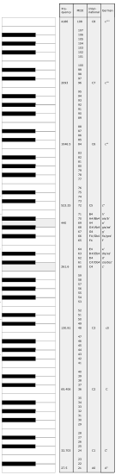
MIDI
Musical Instrument Digital Interface
Industry-standard electronic communication protocol since 1983
Serial interface (3.9 kBps) with defined set of messages
Defines each musical note in an electronic instrument
Allow instruments and computers to exchange data
MIDI does not transmit audio
Transmits digital symbolic information about a performance
Midi data rate is ~ 3.9 kBps
Typical audio rate is ~ 180 kBps (2 channel, 16 bit, 44.1kHz)

Slide 3
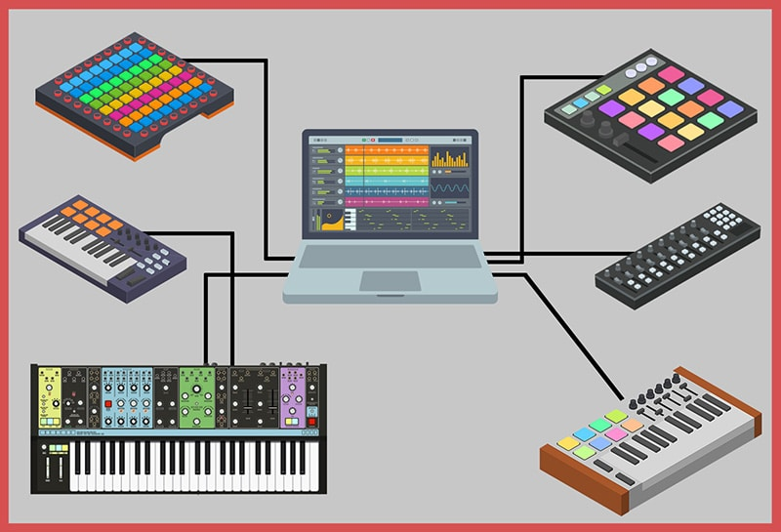
MIDI - Musical Instrument Digital Interface
MIDI stands for Musical Instrument Digital Interface
Began in 1980s as communication standard for synthesizers, MIDI protocol
Developed by major synth manufacturers at the time
Korg
Roland
Yamaha
…
Notes:
MIDI is an acronym for Musical Instrument Digital Interface. It evolved as a communication standard—the MIDI protocol—for synthesizers in the 1980s. It was developed by a group of major synth manufacturers at the time, including Korg, Roland, and Yamaha.

Slide 4
Midi channels
Independent paths over which communication can occur between Midi devices
By assigning channels to particular Midi devices or Midi-enabled sound generators, they can be independently controlled via Midi data
16 Midi channels
Each can be assigned to a different Midi device
Channel assignments allow Midi devices to be arranged in combinations so each device responds only to information intended for it

Slide 5
Midi messages
Used to communicate with midi devices
Midi messages travel between devices on Midi channels
carry small instructions & data intended for device at end of channel
voice information: performance data, such as
what notes to play
how long to hold them
how hard to press keys
mode information: instructions on how receiving device should use performance data that it receives, LIKE
whether to respond to data on any channel or only single channel
whether to play polyphonic (several notes at a time) notes
system-specific information: general system, synchronization & other system-related data

Slide 6
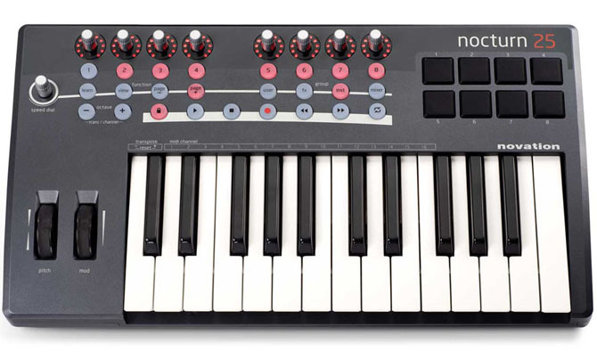
Example MIDI messages
Control Change
Control #, Value
e.g. Modulation, Pan, Effect Levels
Pitch Wheel
Pitch value (up / down)
Note On / Note Off
Note #, Velocity

Slide 7
Midi commands
Most traffic in Midi data stream is Midi voice information
This information carries performance data, also referred to as Midi commands
Midi command is series of numbers which when received by device will cause it to do something
Midi commands convey action to receiving device, such as play note, change sound (Midi program change), or turn off note
Midi activity can take place on all 16 Midi channels simultaneously

Slide 8
Midi commands
Status | Command | DATA 1 (0 - 127) | DATA 2 (0 - 127)
Note OFF | 128-143 | Key # | Off Velocity
Note ON | 144-159 | Key # | On Velocity
Polyphonic Key Pressure | 160-175 | Key # | Pressure value
Control Change | 176-191 | Control # | Control Value
Program Change | 192-207 | Program # | -- Not Used --
Monophonic Key (Channel) Pressure | 208-223 | Pressure Value (0-127) | -- Not Used --
Pitch Bend | 224-239 | Range (LSB) | Range (MSB)
System exclusive | 240-255 | Manufacturer's ID | Model ID

Slide 9
Midi command examples
144 60 127 - turn ON note #60 on Midi channel 1 with a velocity of 127
144 60 0 - turn OFF note #60 on Midi channel 1
192 15 - change the program (sound) on Midi channel 1 to program #15
193 21 - change the program (sound) on Midi channel 2 to program #21
Status | Command | DATA 1 (0 - 127) | DATA 2 (0 - 127)
Note OFF | 128-143 | Key # | Off Velocity
Note ON | 144-159 | Key # | On Velocity
Polyphonic Key Pressure | 160-175 | Key # | Pressure value
Control Change | 176-191 | Control # | Control Value
Program Change | 192-207 | Program # | -- Not Used --
Monophonic Key (Channel) Pressure | 208-223 | Pressure Value (0-127) | -- Not Used --
Pitch Bend | 224-239 | Range (LSB) | Range (MSB)
System exclusive | 240-255 | Manufacturer's ID | Model ID

Slide 10
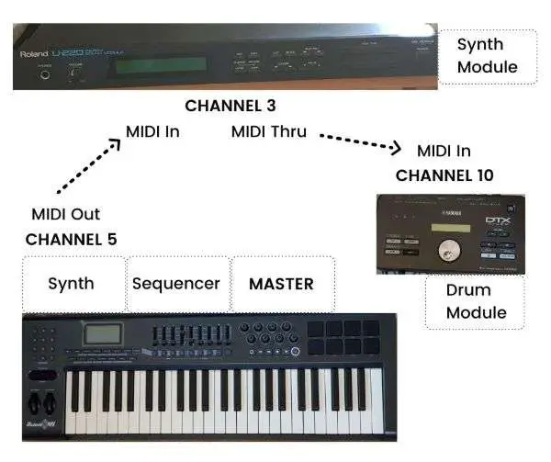
Midi channel assignments
Can send Midi performance data to many devices & specify which device receives what type of data
Suppose Midi device controls (sends Midi information) two receiving devices
Master Midi synth/sequencer connected to synth module
Midi out port to Midi in
Synth module connected to drum module
Midi thru port to Midi in
Thru port passes all information received at Midi in port

Slide 11
Midi channel assignments
By assigning different Midi channel numbers to synth and drum modules, they act only on information intended for them
when you play back sequencer
synth component of master device responds with bass track
synth module responds with melody track
drum module responds with drum track
Arrangement only works properly if Omni Off mode is selected
Assume these channel assignments
Channel 5—Master synth
Channel 3—Synth module
Channel 10—Sampler module
Record with master sequencer using
bass track on Channel 5
melody track on Channel 3
drum track on Channel 10

Slide 12
Midi tracks
Midi tracks refer to Midi sequencing data containing Midi information about notes, chords, melodies, drum beats (in Midi format), etc to be played
In example,
sequencer module in master device stored Midi tracks
bass, melody, and drum sequences that you recorded each represented a Midi track.
Several Midi tracks can come together to form a Midi song
Midi song would essentially be stored as a series of Midi tracks in a Midi sequencer
Similar to audio tracks, but information in Midi track is just set of Midi instructions

Slide 13
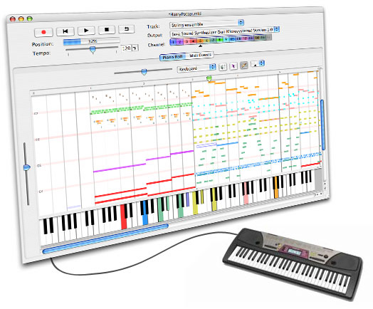
Midi and sequencers
Between interactive & recorded sound
Used in music production for genres like hip-hop, pop, …
sounds are short clips of individual instruments or vocals
Layered according to Midi instructions from sequencer
MIDI sequencer allows composer to re-arrange parts & play them back in fixed order
Sequenced sound in games known as ‘trackers’
Notes:
Between interactive & recorded sound is what we usually call sequenced sound. This is the method of most music production in use today for genres like hip-hop, rock & pop. The sounds are short recorded clips of individual instruments or vocal lines which are layered together according to instructions stored in a sequencer, often as MIDI data. The MIDI sequencer acts as a tool for a composer to re-arrange the recorded parts & then play them back in a fixed order. Sequenced sound has been used in games for a long time in the guise of "trackers", but this has fallen into disuse for reasons we will examine later.

Slide 14
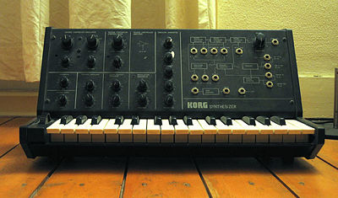
Midi and synthesisers
Produced by hardware or simulations of oscillators & filters
Synthesisers produce audio waveforms with dynamic shape, spectrum & amplitude characteristics
Can correspond to real instruments, or completely imaginary ones
But performance is typically generating midi commands
Sequencers & synthesisers used in electronic music and other genres
Can also produce
ambient backgrounds
non-musical sound effects like rain, wind, thunder …
Notes:
Synthetic sounds are produced by electronic hardware or digital hardware simulations of oscillators & filters. Sound is created entirely from nothing using equations which express some functions of time & there need not be any other data. Synthesisers produce audio waveforms with dynamic shape, spectrum & amplitude characteristics. They may be generated for sounds corresponding to real instruments like brass or piano, or for completely imaginary ones. The combination of sequencers & synthesisers is mainly responsible for the genre of techno & dance music but can produce ambient backgrounds too. Synthesisers also play a non-musical role for creating sound effects like rain, wind, thunder or just about anything you care to imagine. The power of synthetic sound is that it is unlimited in potential, just as long as you know how to figure out the equations needed for a certain sound.

Slide 15
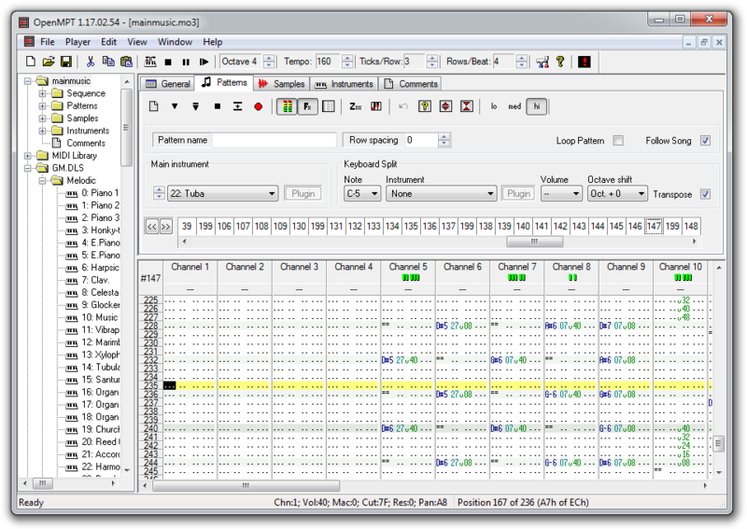
Midi and game music
Composer concerned with shape & boundaries of how piece performed, not definitive form
Instead of deliver mixed tracks or multitrack stems, composer uses tracker philosophy
Music tracker - represent music tracks as notes positioned in several channels, at discrete times
Music delivered as;
MIDI score components determine themes, melodies & transitions
metadata for assembling scores according to real-time emotive states
set of instruments , either multi-sample libraries or synthesised
Notes:
Instead of delivering mixed tracks or multitrack stems for clientside mixing the composer now returns to the earlier tracker style philosophy (only in a more modern incarnation with XMF, DLS2, EAS type formats). Music is delivered in three parts, MIDI score components that determine the themes, melodies & transitions of a piece, a set of "meta" data or rules for assembling scores according to real-time emotive states, & a set of instruments which are either multi-sample library banks or synthetic patches. The composer is no longer concerned with a definitive form for a piece, but rather with the ``shape" & ``boundaries" of how the piece will perform during play. Chipset MIDI on some soundcards has improved greatly in recent years reaching par with professional samplers & synthesisers, but for platform independence the most promising direction is with native implementations.

